Slide 1


SHOPEE PROMOTION EMAIL CAMPAIGN PREDICTION
BY
WIDAGDO, JOHAN KLEMANTAN
2100503201019901
JCDS 0506-BANDUNG

Slide 2

01
TABLE OF CONTENTS
02
03
OVERVIEW
Problem Background
Goals
Dataset Source
DATASET INFORMATION
Information about Train & User Dataset
PROJECT STEP
Business Understanding, Engineering & Planning, Data Cleaning
Exploratory Data Analysis
Machine Learning
Deployment

Slide 3
01
OVERVIEW
BACKGROUND
Sending email is one of the alternatives used by Shopee to tell and promote certain event sale to users. With the ability to be able to predict whether user is reading or not reading the email, enable Shopee to evaluate their crew works during campaign period until event launch. This is because, when user is open the email, the possibility of that user know there is an event or promo will be highly increased and also increasing the possibility of that user do transaction during event period. Therefore, with the making of this model, hopefully Shopee able to build a strategy for future marketing.

Slide 4
01
OVERVIEW
GOALS
The goals of this project is to build model that able to predict whether user is going to read the email sent by Shopee. In this case, Shopee's priority is user.
DATASET
This dataset was taken from Kaggle about Shopee’s Email Campaign Analysis

Slide 5

DATASET INFORMATION
02
Train Dataset Contains
18 columns and 73.539 rows
User Dataset Contains
6 columns and 127.886 rows
These two dataset merged using column user_id

Slide 6
IMPORTANT FEATURE, TYPE, AND INFORMATION
Name | Type | Description
country_code | Integer | Code Number of Country in Shopee's user
grass_date | Object | Date when the email was sent
user_id | Integer | Unique number each user
subject_line_length | Integer | Character Length for subject of email sent
last_open_day | Object | How many days this users last open their email
last_login_day | Object | How many days this users last open their Shopee account
last_checkout_day | Object | How many days this user last checkout at his Shopee account

Slide 7
IMPORTANT FEATURE, TYPE, AND INFORMATION
Name | Type | Description
open_count_last_ [10/30/60]_ days | Integer | Total email that open during N days
login_count_last_ [10/30/60]_ days | Integer | Total times this user open his Shopee account during N days
checkout_count_last_ [10/30/60]_ days | Integer | Total times this checkout from his Shopee account during N days
Attr_[1/2/3] | Float | General attribute each user
Age | Float | Age of the User
Domain | Object | Email Domain of Each User
TARGET VARIABLE
Open_flag | Integer | Whether this users open their Email or not

Slide 8

03
PROJECT STEP

Slide 9
PROJECT TIMELINE
STEP 01
STEP 03
STEP 02
STEP 04
01
03
02
04
Understanding the problem, Feature Engineering, and Pipeline Planning
Machine Learning, Tuning, Threshold, and Evaluation
Visualizing Data for more better understanding of target
Deployment to Front End

Slide 10
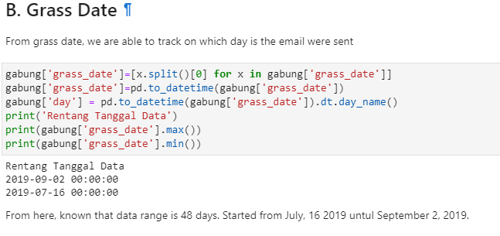
STEP 01 FEATURE ENGINEERING
GRASS DATE
1. Check sample data date
2. See if there is holiday in there
Convert Into Days

Slide 11
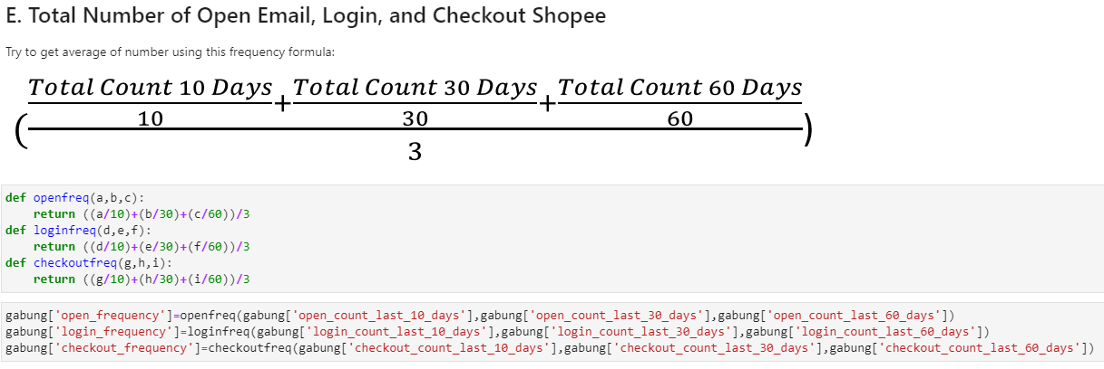
FEATURE ENGINEERING
TOTAL NUMBER OF EMAIL, LOGIN SHOPEE, AND CHECKOUT SHOPEE
1. Check Correlation to Target
2. See the Pattern
Develop New Feature From 3 Features With Same Range of Correlation

Slide 12
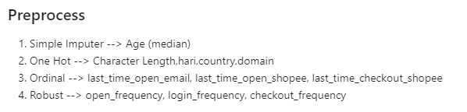
PIPELINE PREPROCESS PLANNING
Preprocess Planning for Pipeline Modeling
Some new generated feature needs to be preprocessed before fitted into the model

Slide 13
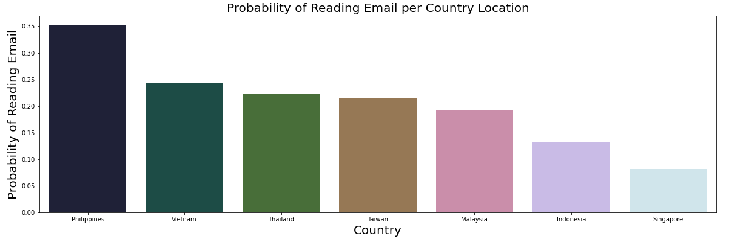
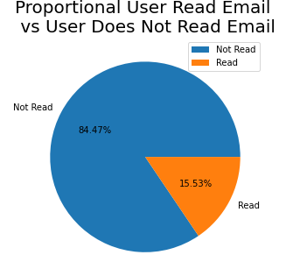



STEP 02 EXPLORATORY DATA ANALYSIS
Target Variable
Country
Philippines is the most country with user’s ratio to read the email promotion, followed by Vietnam and Thailand
Only 15% of user from the dataset were actually reading the Email

Slide 14
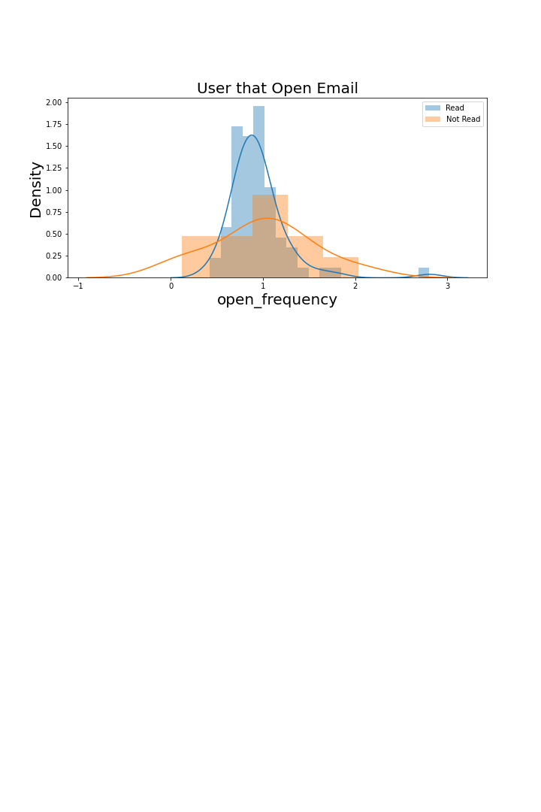
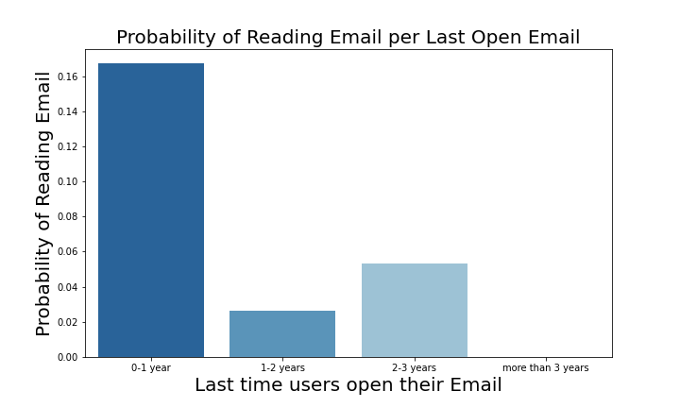
Opening Email
User that’s most likely to read the promotion email, actually open their Email 0.8-1.2 times per day
User that’s most likely to read the promotion email, open their email in the last 1 year at least once.

Slide 15
AGE BINING
ELDER
For easier visualization,
age were categorized into 5 class, such as :
15-18 YEARS OLD
18-25 YEARS OLD
25-35 YEARS OLD
35-55 YEARS OLD
55-90 YEARS OLD
HIGH SCHOOL
UNIVERSITY
WORKING
FAMILY

Slide 16
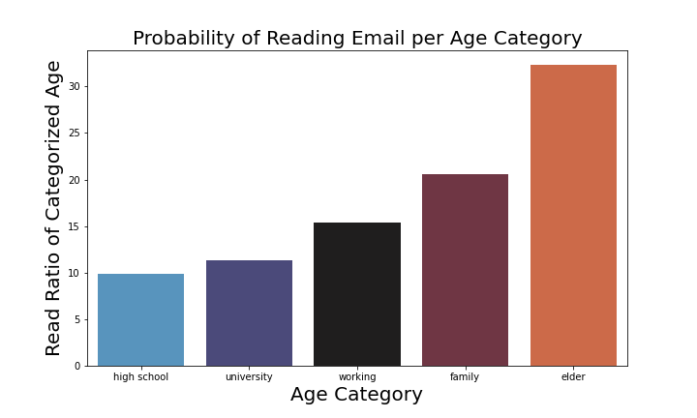
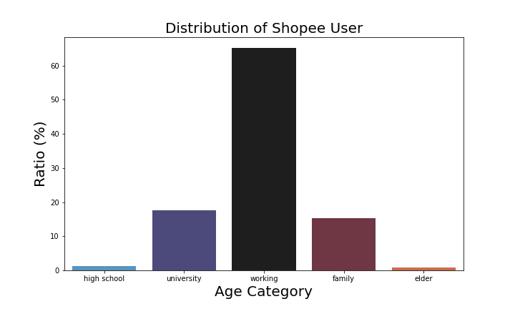
FACTS ABOUT AGE
ELDER
WORKING
Elder is the highest ratio of age category to be likely reading the email. 1/3 Eldery Will Read the Promotion Email
33%
2/3 Shopee’s User on Age Category Working
65%

Slide 17

STEP 03 MACHINE LEARNING
3-3-1 DATA SPLITTING
3-3-3 TUNING
3-3-2 BUILD PIPELINE
3-3-4 THRESHOLD CHANGE
Split the Data Train & Test with Ratio 80:20 and random_state = 2021
Searching the best parameter of chosen model
Transformer for Preprocessing Data
Resampling for Imbalance Data
Feature Selection
Classifier for Model
Change the Threshold as per business problem

Slide 18
RESULT
In this case, Shopee wants to focus on making sure that customer that supposed to read the email, actually getting the email. So, in this case, want to focus minimalizing False Negative. Hence, Recall score was used
RECALL SCORE
MODEL | BENCHMARK | TUNED
DECISION TREE CLASSIFIER | 46,5 | -
LOGISTIC REGRESSION | 72,4 | 73,4
GAUSSIAN NAÏVE-BAYES | 64,8 | 75,6

Slide 19
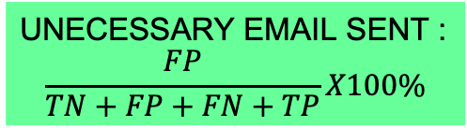
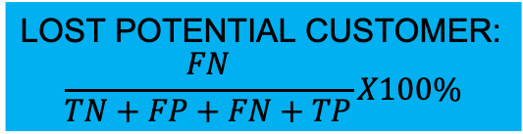
Prediction | Actual
 |  | Negative | Positive
 | Negative | TN | FP
 | Positive | FN | TP
TN : User that did not read the email and predicted will not read
FP : User that did not read the email but predicted will read
FN : User that read the email but predicted will not read
TP : User that read the email and predicted will read
UNECESSARY EMAIL SENT :
$$\frac{FP}{TN+FP+FN+TP}X100\%$$
LOST POTENTIAL CUSTOMER:
$$\frac{FN}{TN+FP+FN+TP}X100\%$$

Slide 20
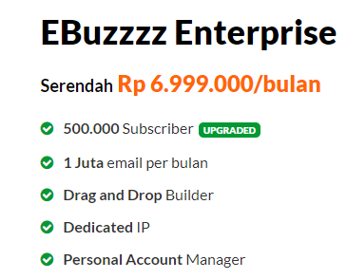
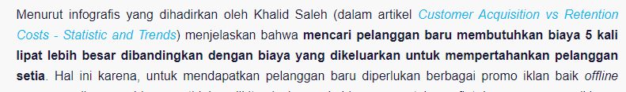
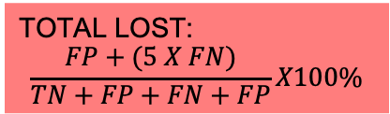
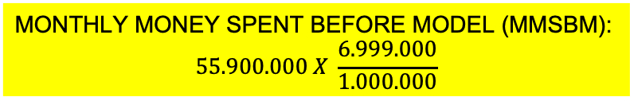
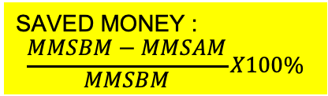
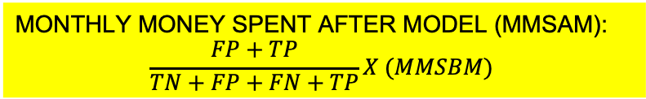
Pada Q3 tahun lalu, jumlah pengunjung Shopee adalah 55,9 juta orang sementara tahun ini jumlah pengunjungnya mencapai 96,5 juta atau meningkat sekitar 72%. Selain Shopee, Tokopedia pun menunjukkan angka yang serupa. Pada Q3 tahun 2019, jumlah pengunjung Tokopedia mencapai 65,9 juta sementara tahun ini mencapai 84,9 juta (meningkat 28%)
MONTHLY MONEY SPENT BEFORE MODEL (MMSBM):
$$55.900.000 X \frac{6.999.000}{1.000.000}$$
SAVED MONEY :
$$\frac{MMSBM−MMSAM}{MMSBM}X100\%$$
MONTHLY MONEY SPENT AFTER MODEL (MMSAM):
$$\frac{FP+TP}{TN+FP+FN+TP}X (MMSBM)$$
TOTAL LOST:
$$\frac{FP+(5 X FN)}{TN+FP+FN+FP}X100\%$$

Slide 21
EVALUATION LOGISTIC REGRESSION
LOGISTIC REGRESSION
PARAMETER/ MODEL | BENCH MARK | TUNED | BEST MODEL & THRESHOLD (0.49)
UNECESSARY EMAIL SENT (%) | 13,47 | 13,66 | 14,11
LOSS POTENTIAL CUSTOMER (%) | 4,17 | 4,13 | 4,01
MONEY SAVED (%) | 75,16 | 74,92 | 74,36
TOTAL LOST (%) | 34,36 | 34,31 | 34,18

Slide 22
EVALUATION GAUSSIAN NAÏVE-BAYES
GAUSSIAN NAÏVE-BAYES
PARAMETER/ MODEL | BENCH MARK | TUNED | BEST MODEL & THRESHOLD (0.3)
UNECESSARY EMAIL SENT (%) | 11,14 | 22,69 | 14,52
LOSS POTENTIAL CUSTOMER (%) | 5,46 | 3,80 | 4,38
MONEY SAVED (%) | 78,78 | 65,57 | 74,31
TOTAL LOST (%) | 38,44 | 41,70 | 36,44

Slide 23
290mil Rupiah
CONCLUSION
The best model is Logistic Regression with Threshold setting of 0.49
This model saves about 74,36% monthly for advertising through email or around
This model has the least total lost (34.18%) compared to the other model fitted

Slide 24
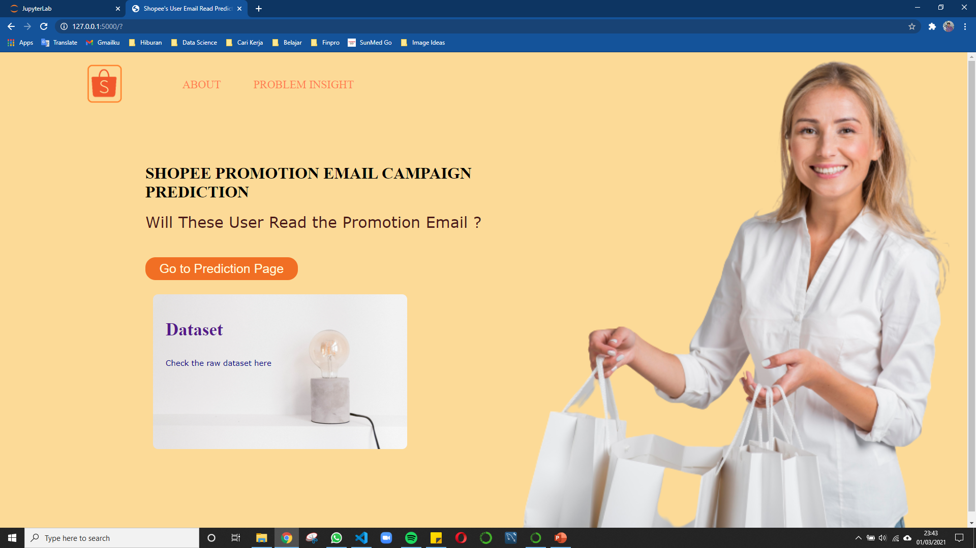
STEP 04 DEPLOYMENT
HOME

Slide 25
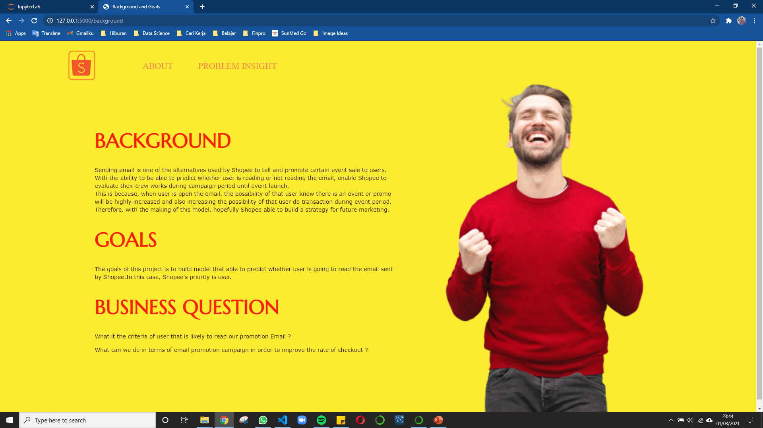
STEP 04 DEPLOYMENT
ABOUT

Slide 26
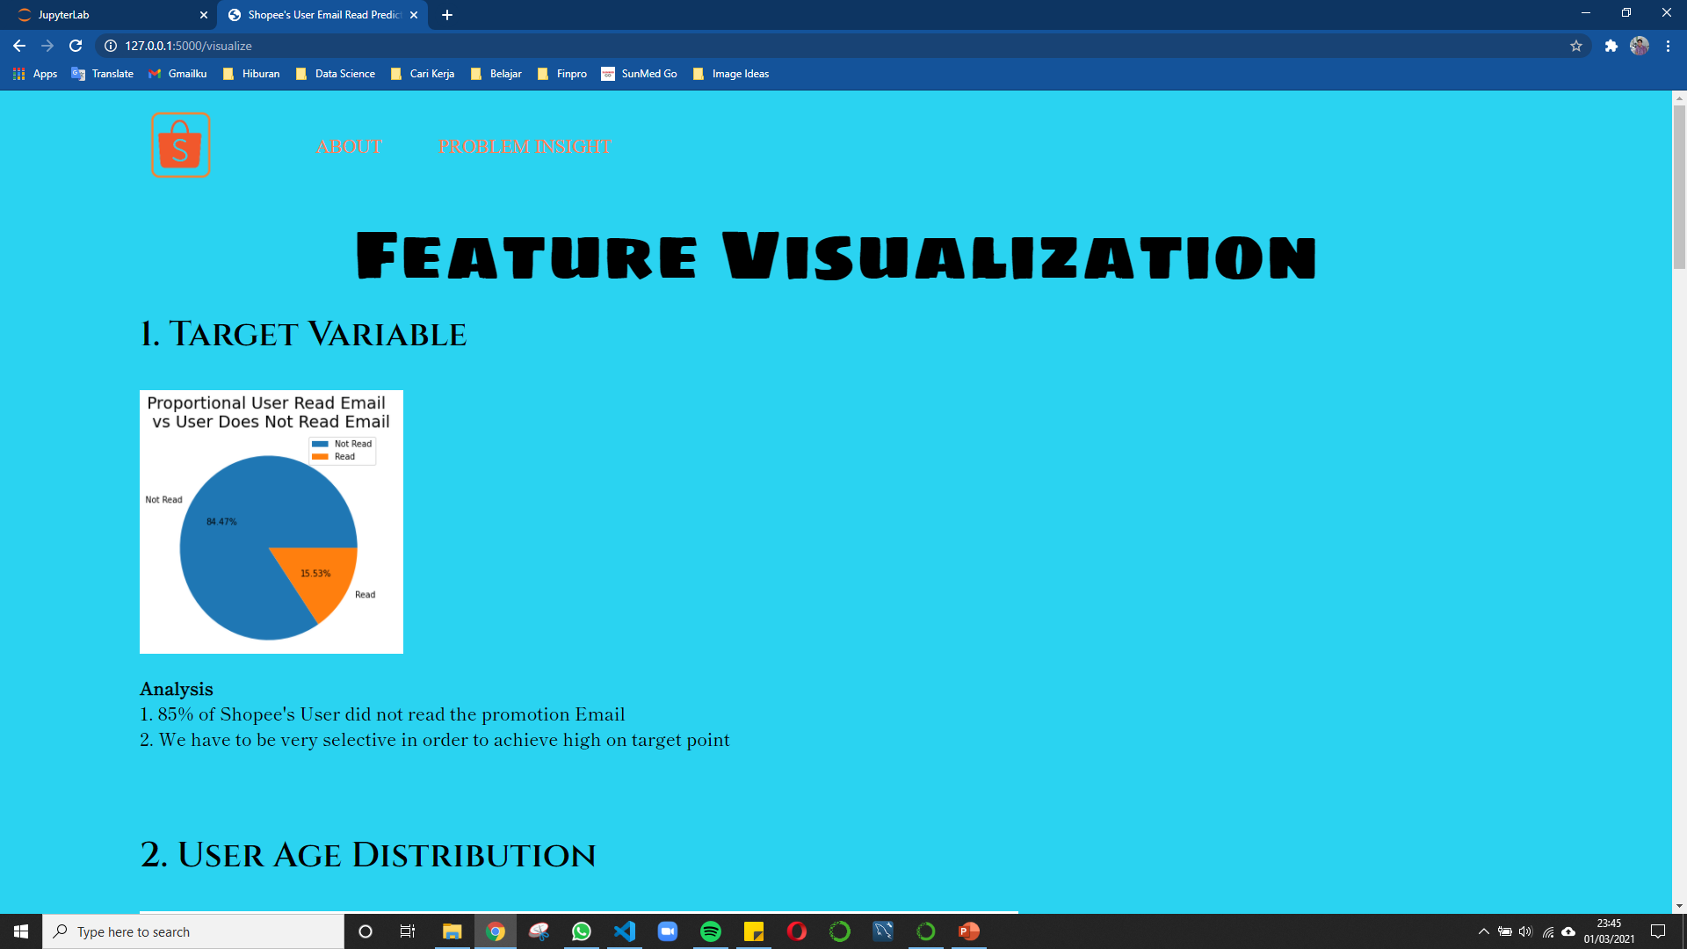
STEP 04 DEPLOYMENT
PROBLEM INSIGHT

Slide 27
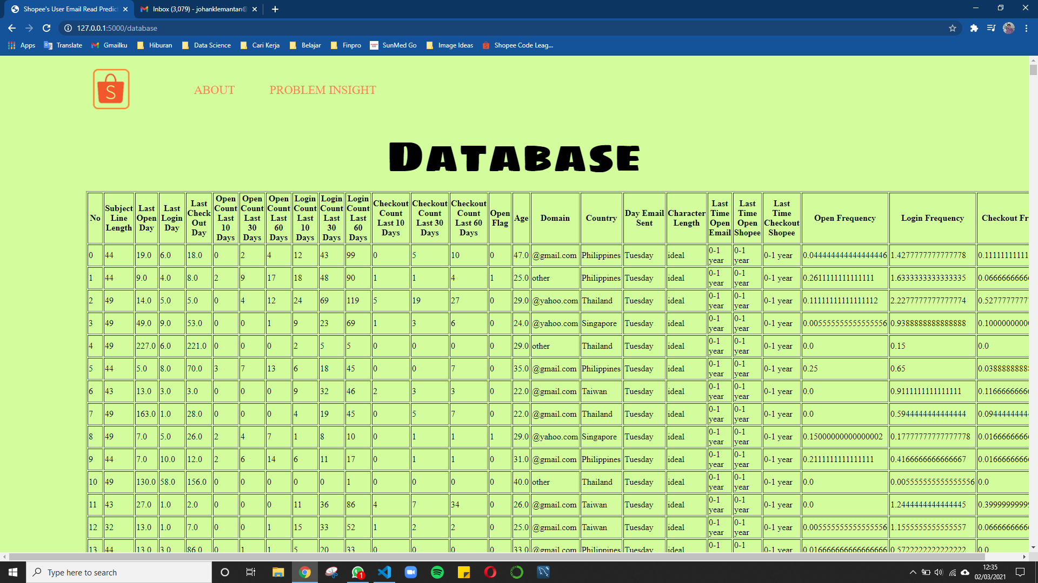
STEP 04 DEPLOYMENT
DATABASE

Slide 28
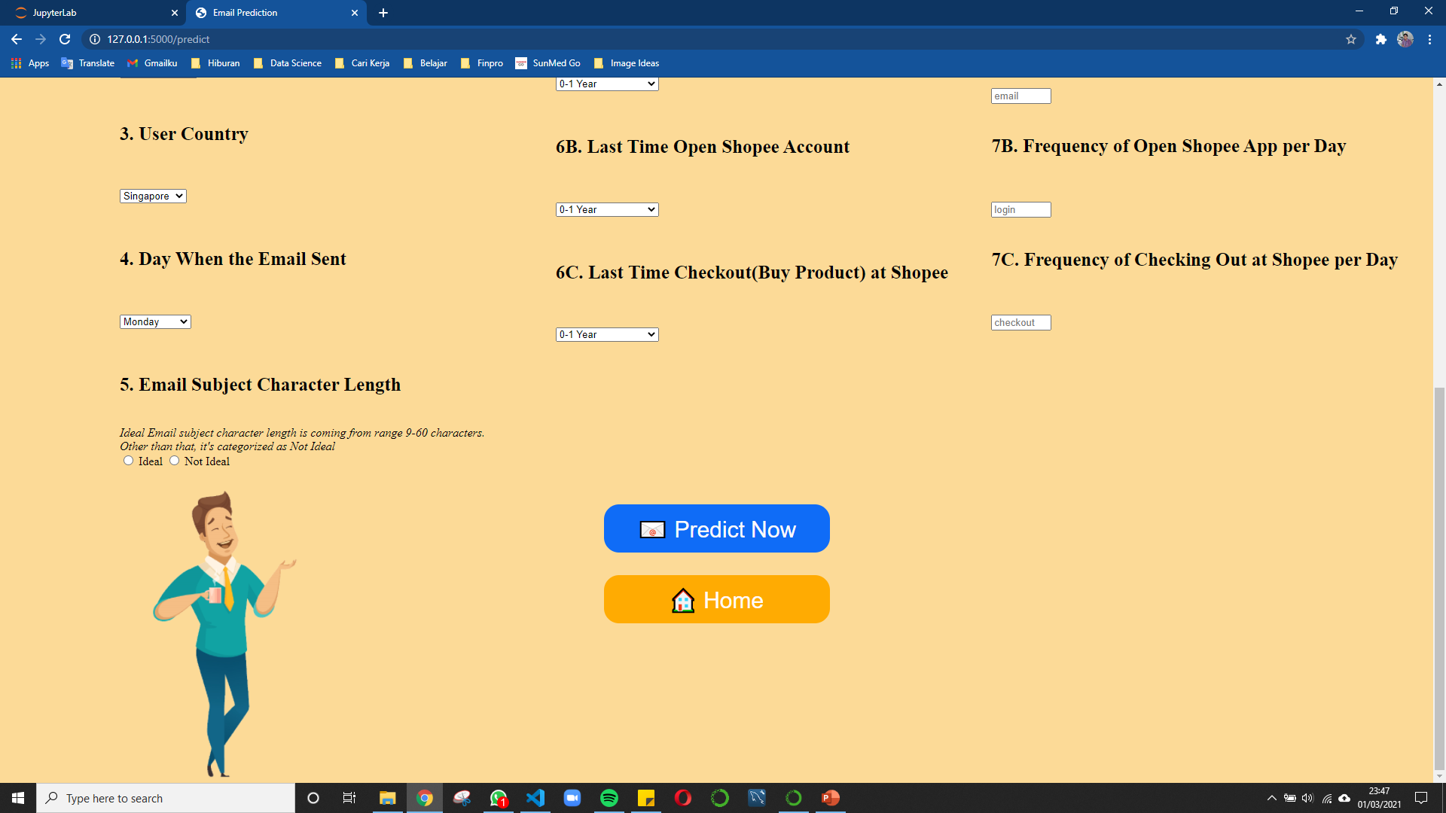
STEP 04 DEPLOYMENT
PREDICTION

Slide 29
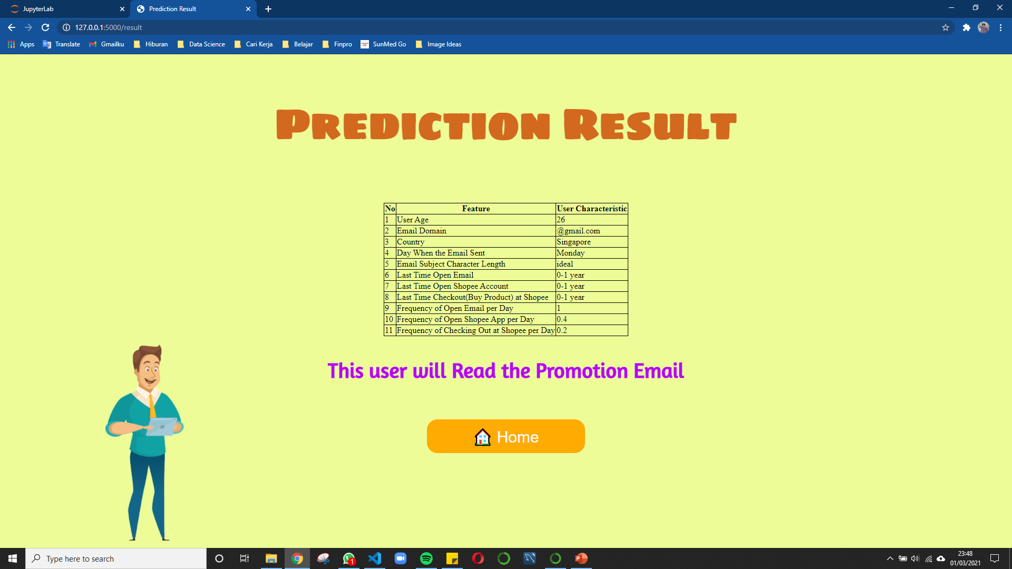
STEP 04 DEPLOYMENT
RESULT YES

Slide 30
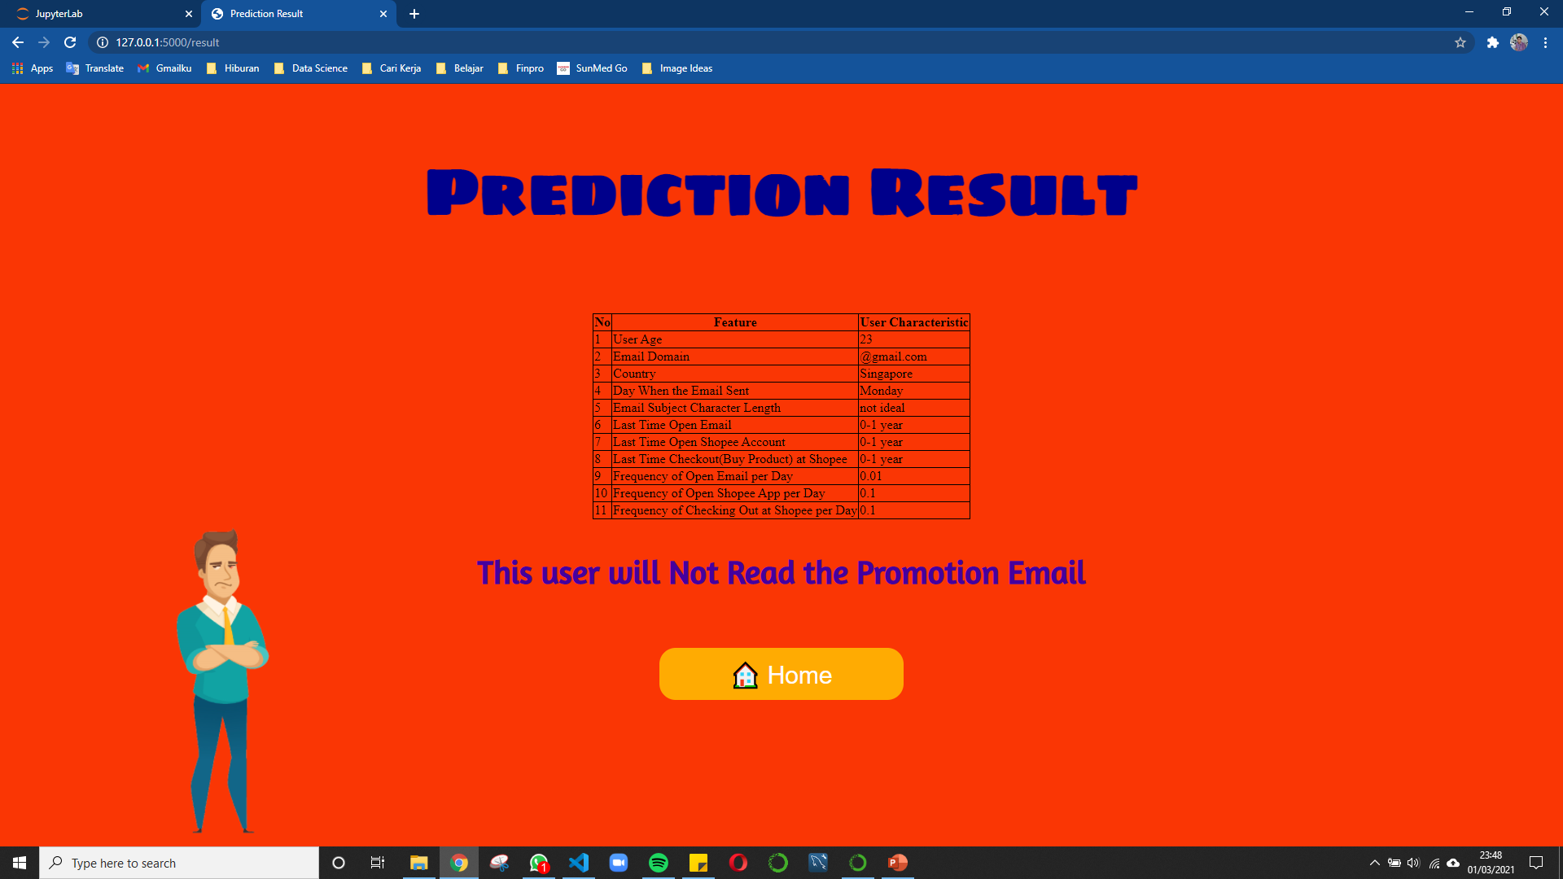
STEP 04 DEPLOYMENT
RESULT NO

Slide 31
FUTURE IMPROVEMENT
Further study for the ultimate goal (increase the number of users who do checkout during promo day)
Increase more feature (user pay with e-money, which e-money platform), will be more accurate to predict users who open email
Study further about promotion email effective technique
Improve UI dashboard for better User Experience

Slide 32
THANKS!
Do you have any questions?
You can find me at
johanklemantan@gmail.com
Johan Klemantan Widagdo
Johan Klemantan Widagdo
@johanklemantan
+62 81 3944 285 71

